Slide 1
ADCP observations of migration patterns of zooplankton in the Cretan Sea
E. Potiris, C. Frangoulis, M. Ntoumas, M. Pettas, A. Kalampokis and G. Petihakis
Institute of Oceanography, Hellenic Centre for Marine Research, Gournes Pediados, Iraklion, Crete, Greece
OceanSITES 2016: 11th Steering Committee, 25 - 29 April 2016, NOC Southampton, UK

Slide 2
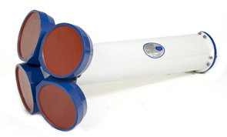
Principle of operation
Sound pulses are transmitted from the transducer
Scatterers inside the water reflect the sound pulse
The time delay of the transmitted pulse correspond to a certain distance from the transducer
The energy of the reflected signal can be used to estimate the amount of scatterers at a certain distance from the transducer

Slide 3
Methodology
Deines, K. L.: Backscatter estimation using Broadband acoustic Doppler current profilers, pp. 249–253, IEEE. 1999
Notes:
A working sonar equation → To convert raw echo readings to absolute values Slant range is the distance from the transducer in the direction of the beam
Sv is the backscatter due to material inside the sound lobs The first part corrects the slant
We must cancels the effects of sound absorption, geometric attenuation and Tempof transducer the second corrects the distance due to difference in the speed of sound
Several parameters not known to the user are included in constant C.
Other parameters are set by the user during deployment (sound speed used by the ADCP).
The rest parameters are measured and calculated externally (T, S, sound speed)

Slide 4
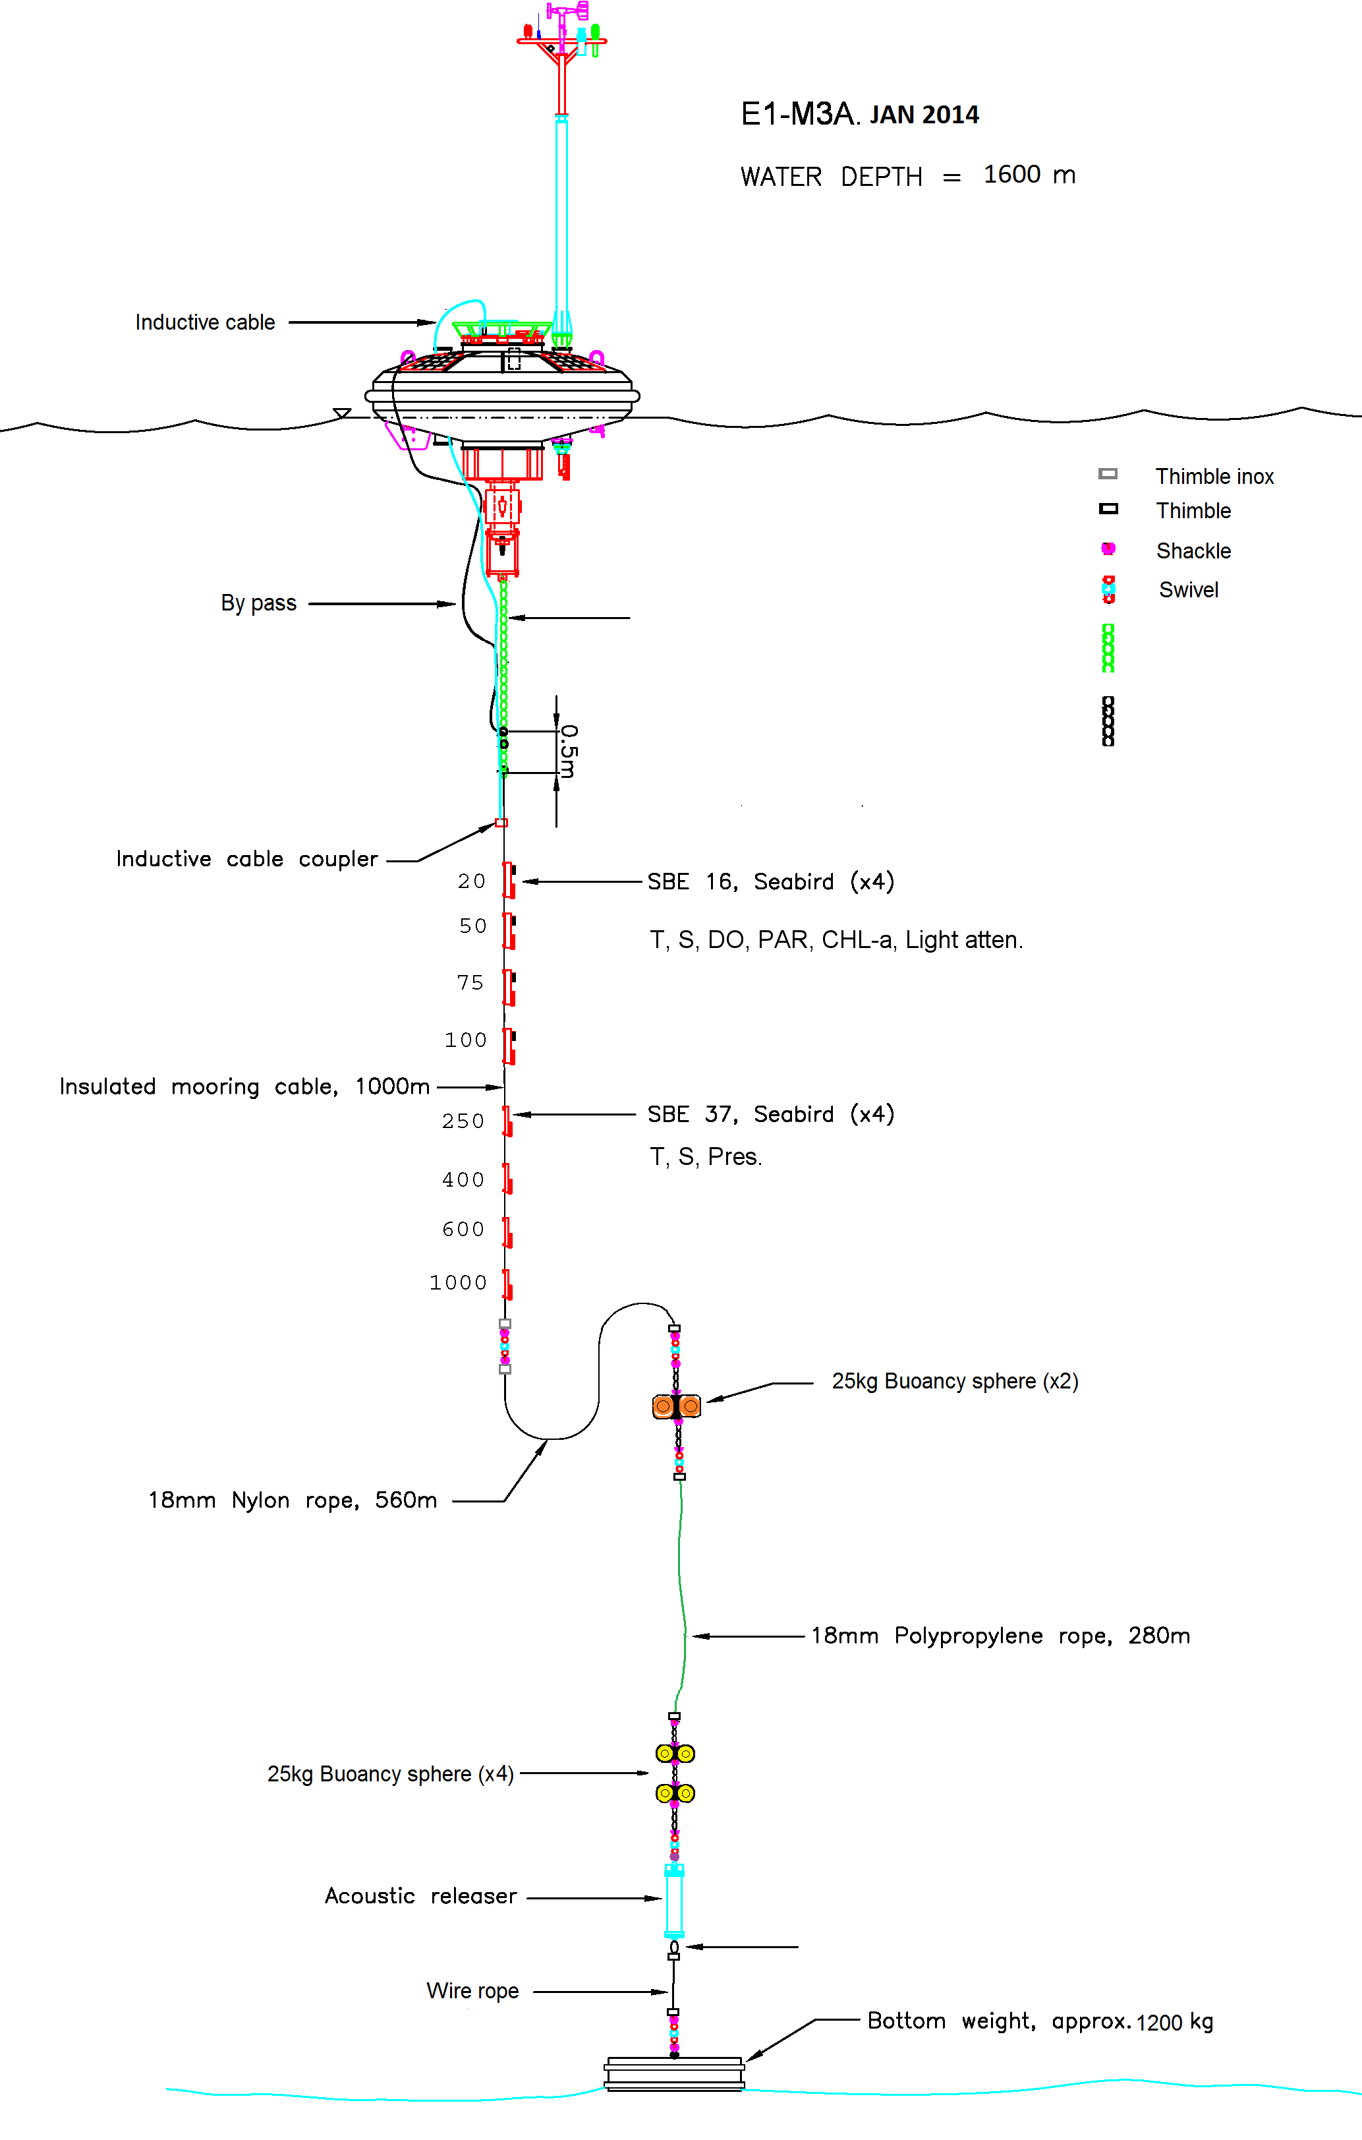
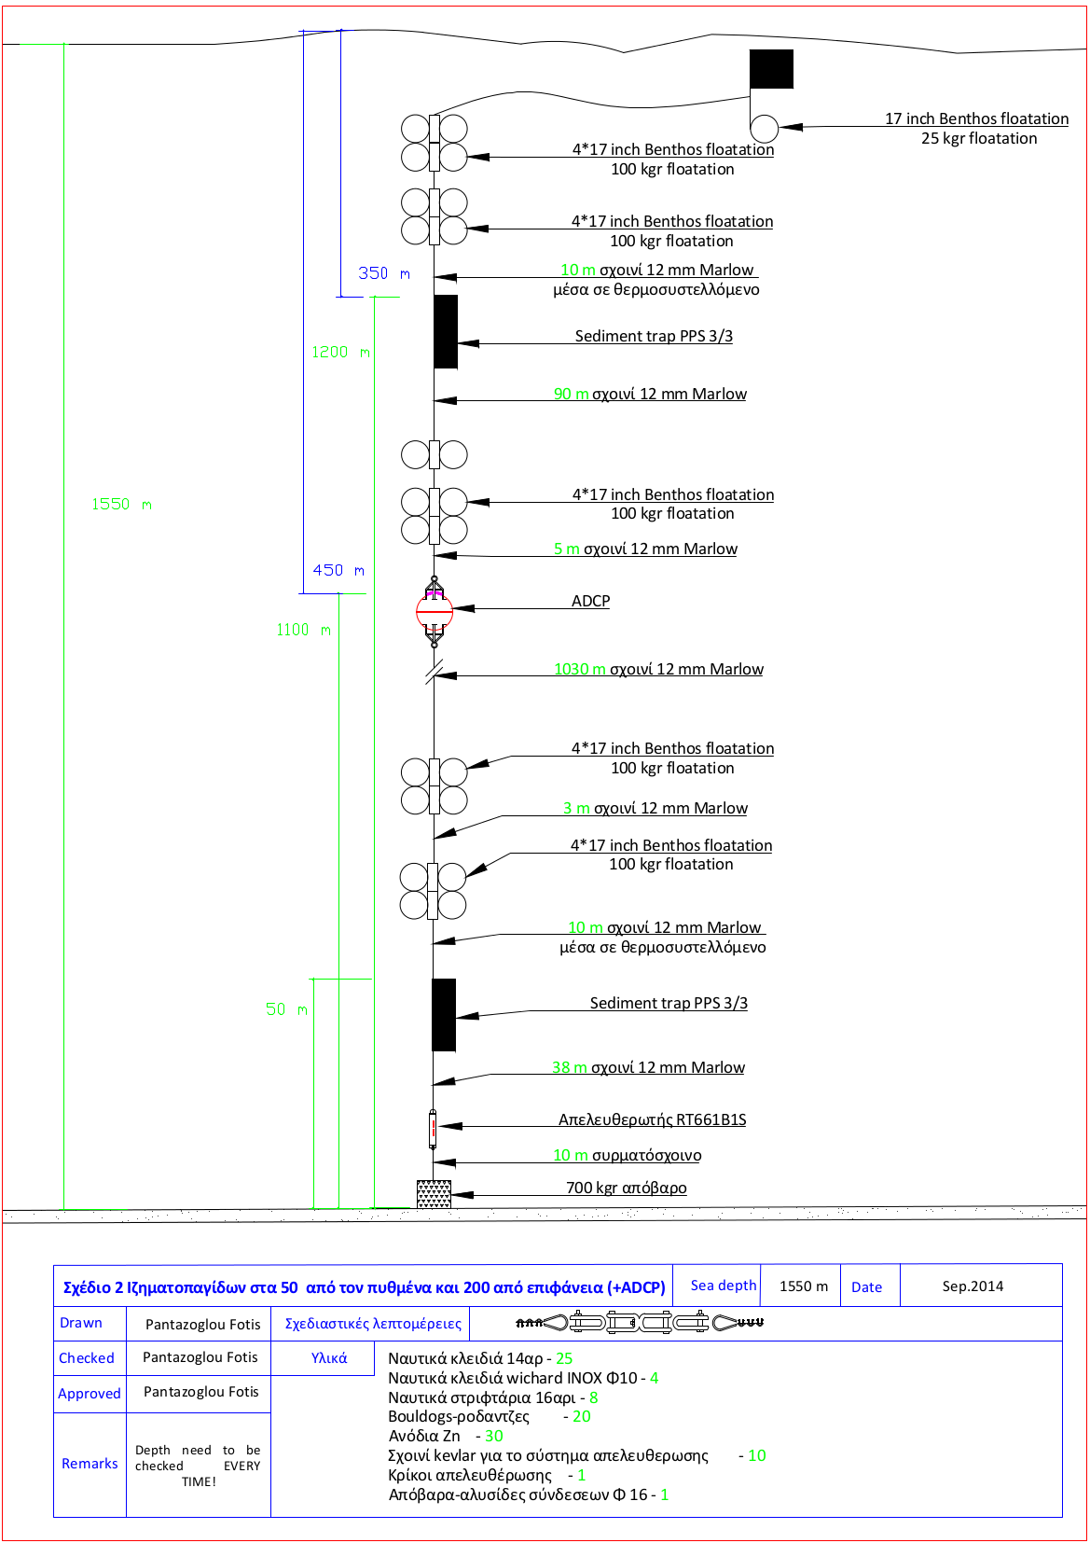
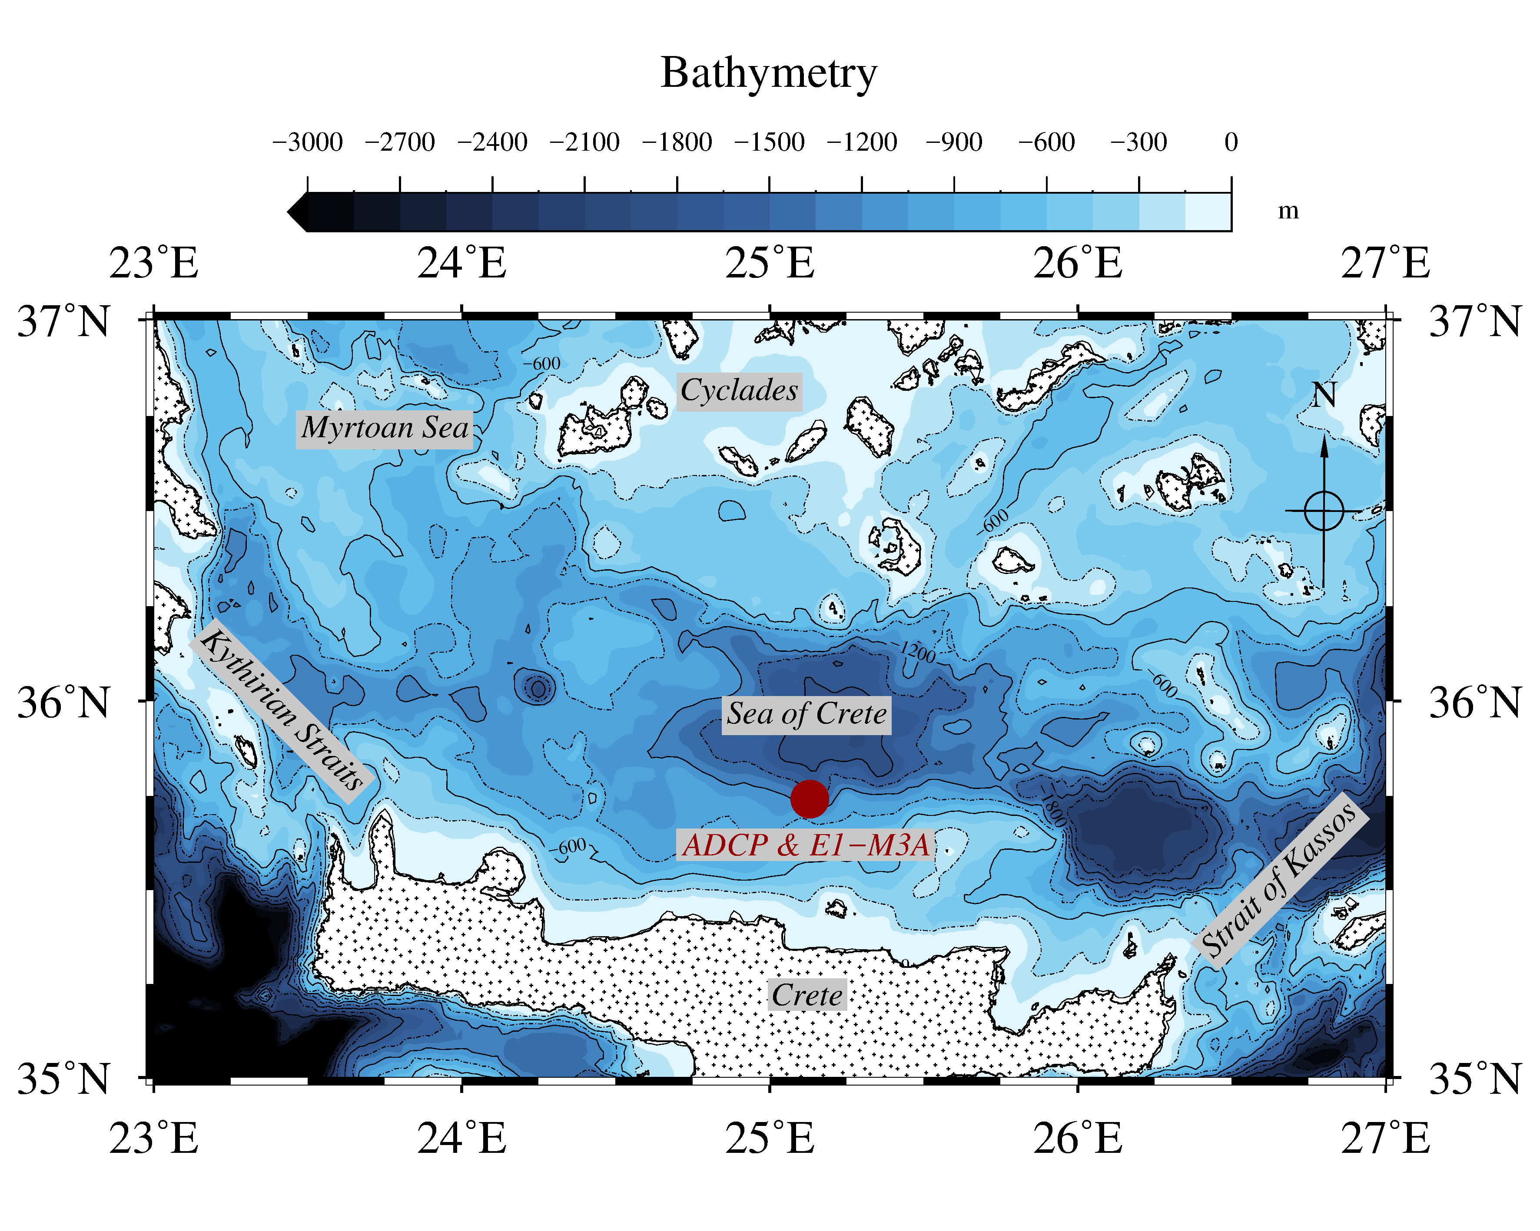
Case study
Area: Cretan Sea (South Aegean)
Bottom depth: 1500m
Data sets:
2.6 years of ADCP measurements
E1-M3A
R/V monitoring

Slide 5
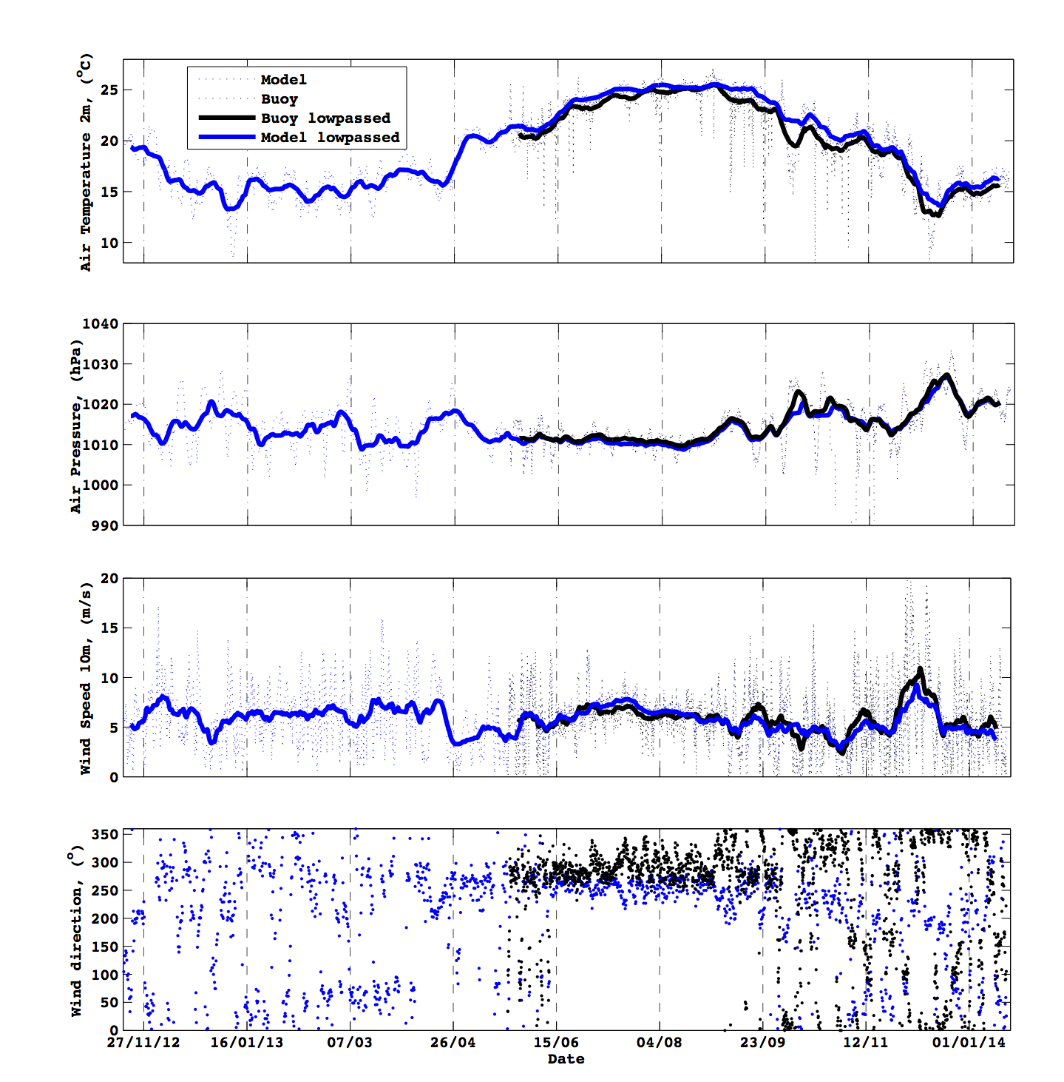
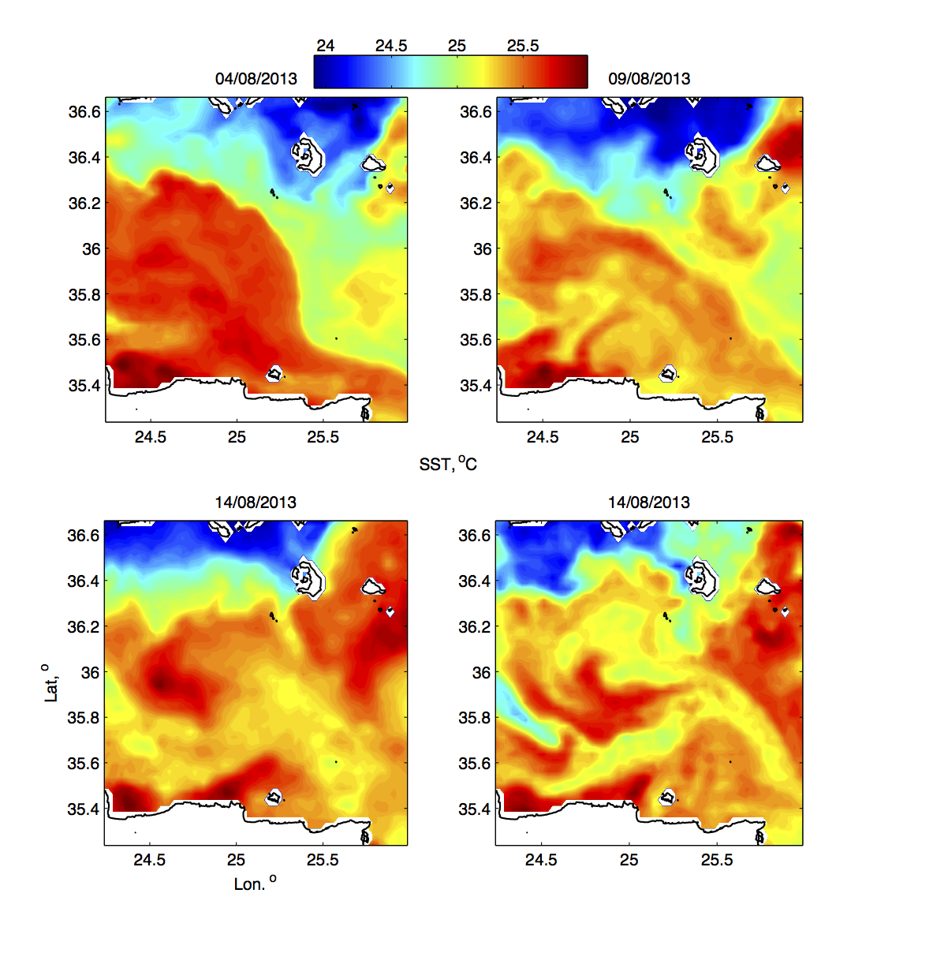
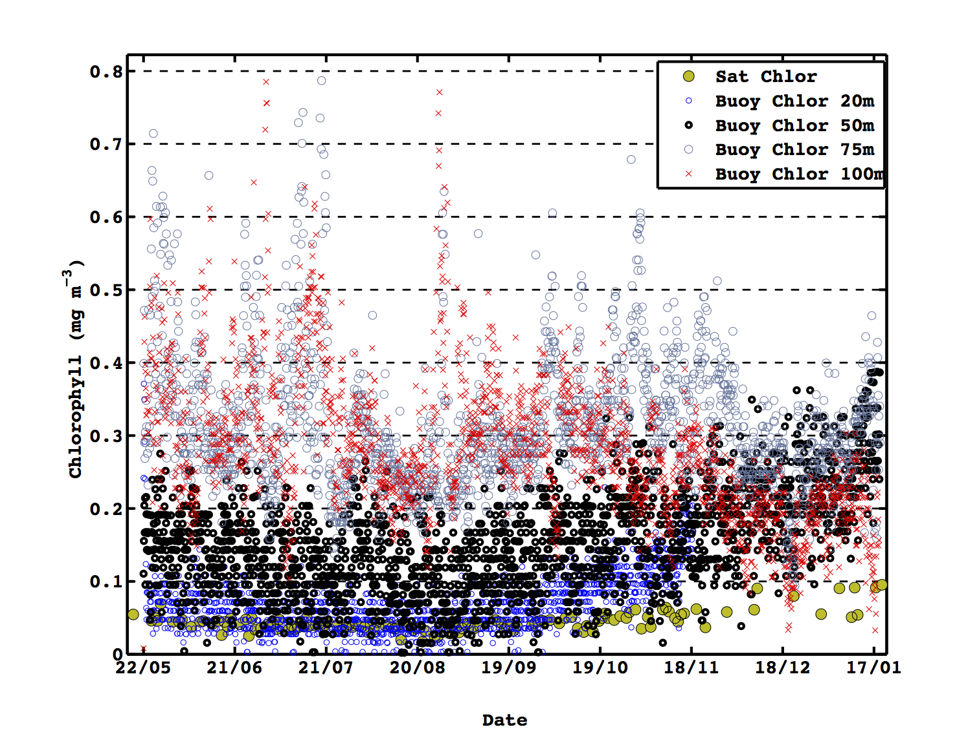
Auxiliary data
Sound speed
Water Absorbance
Atmospheric conditions
SeaDataNet climatologies (T,S,pH)
  Estimation of sound speed and absorption coefficient
POSEIDON operational data & forecasts
  Fill in situ data gaps
ERA INTERIM re-analysis
  Assess atmospheric climatology
Satellite cloudiness and SST
  Changes in light intensity
  Surface circulation
Special events
SST – Surface circulation
Chlorophyll
Notes:
T,S for sound speed - T,S,pH are used to calculate the absorbance due to water
ERA INTERIM re-analysis → to see the particulate characteristics in the area ie special events etc
Satellite cloudiness and SST → as auxiliary data
SST (middle) → reversal of the typical surface circulation of the Cretan under the influence of the etessians
Cold water advected from the east cyclades are pushed on the NW Crete under the influence of NW winds.
When the winds stops the surface circulation adjusts to the sub basins gyres

Slide 6
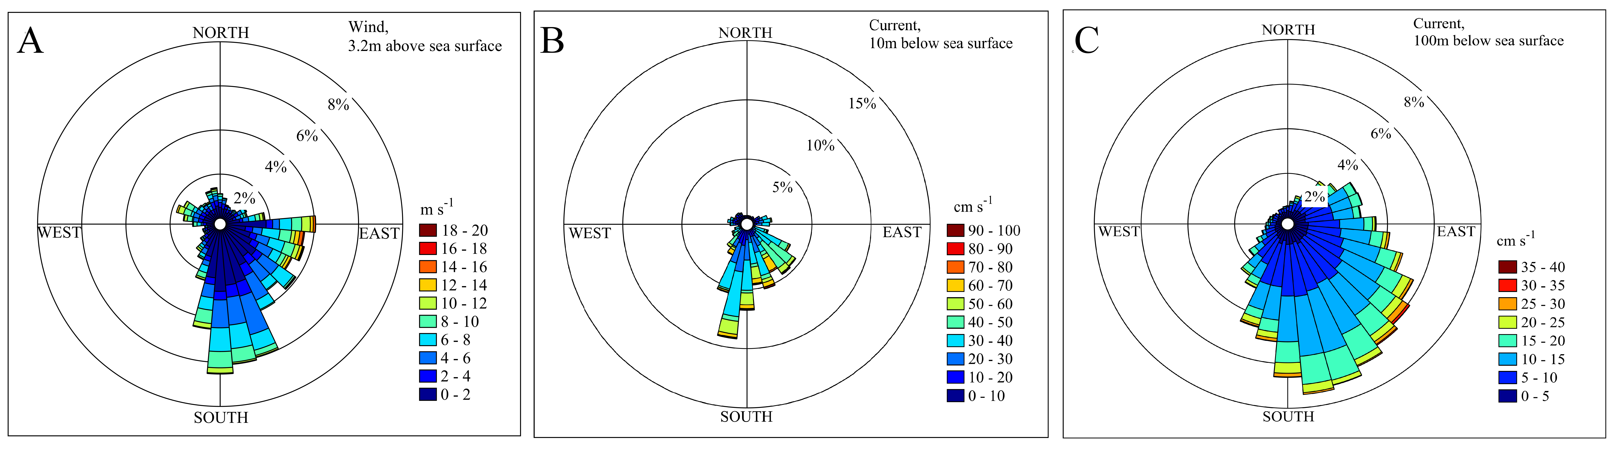
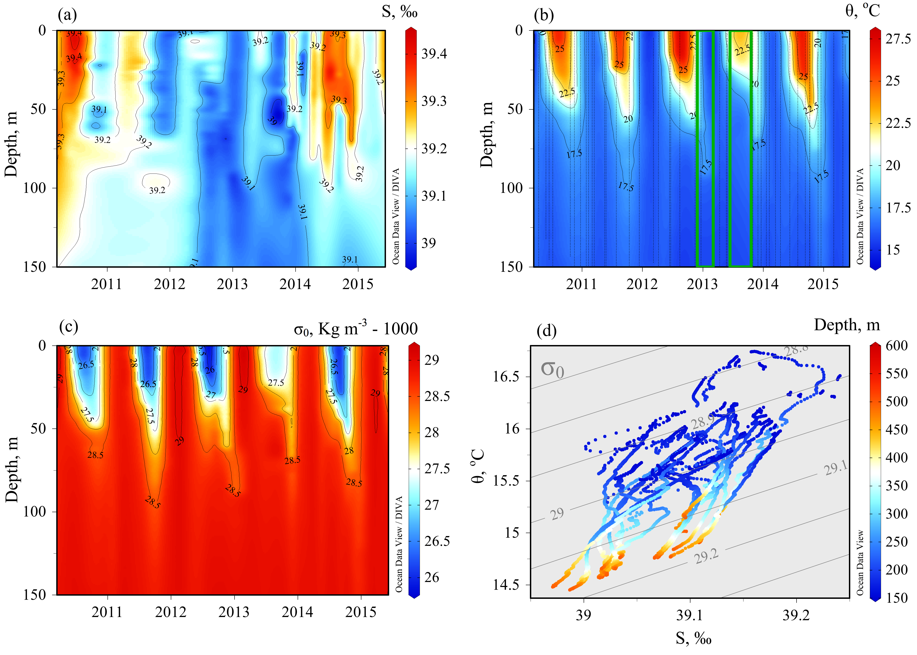
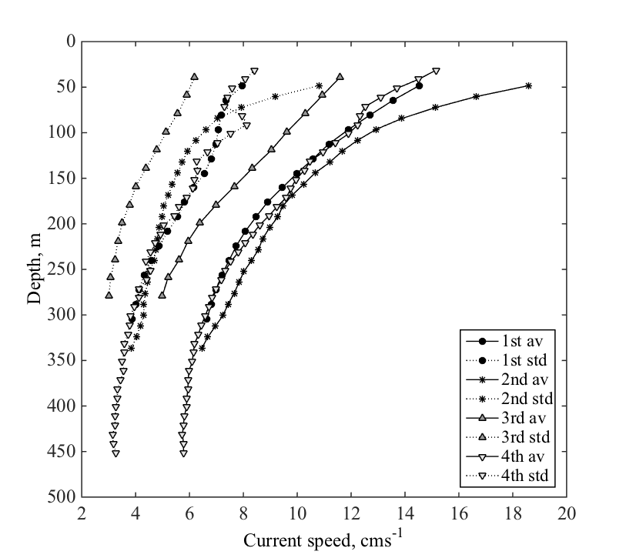
Environmental conditions
Unidirectional
~25cm/s
Less Unidirectional
Hydrology
Circulation
Exponential decay
Notes:
Hydrology
Water properties and mostly the density gradients, may affect migrators → Dumping of migration?
Sound (and thus estimation of backscatter) is affected when travelling through water masses of different characteristics → reflection, change of speed
Circulation
Vertical structure of horizontal currents is important. Zooplankton cannot swim effectively against the current → advected
Shallow circulation → variable speed but unidirectional, ~25cm/s on average, affected by wind
Mid-depth circulation → exponential decay, less unidirectional

Slide 7
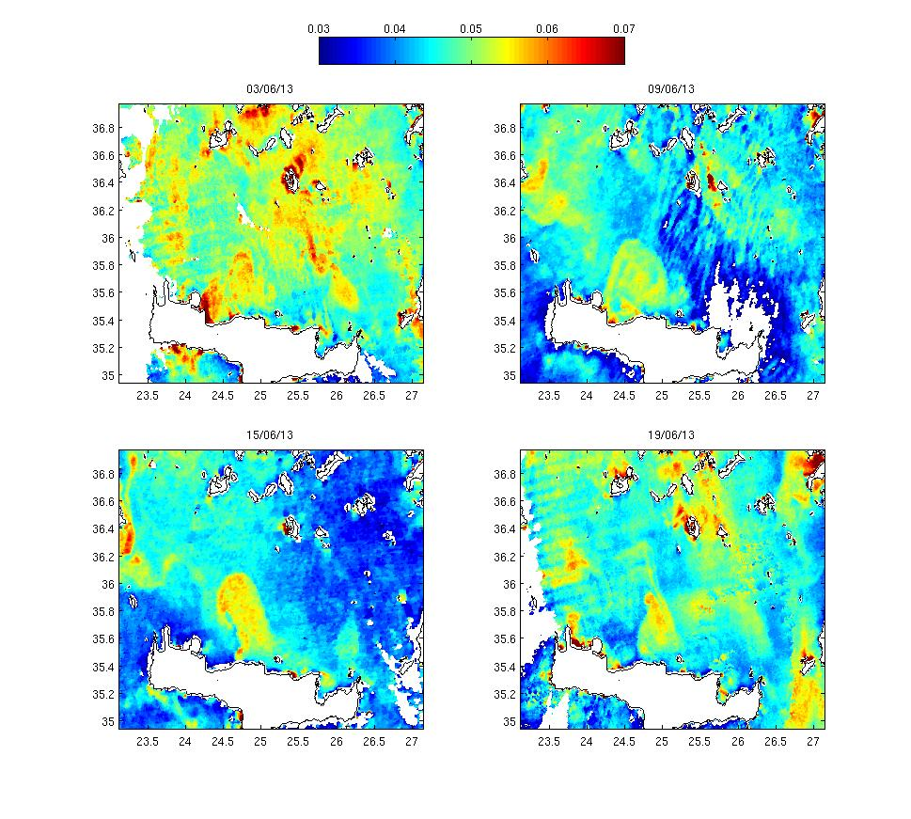
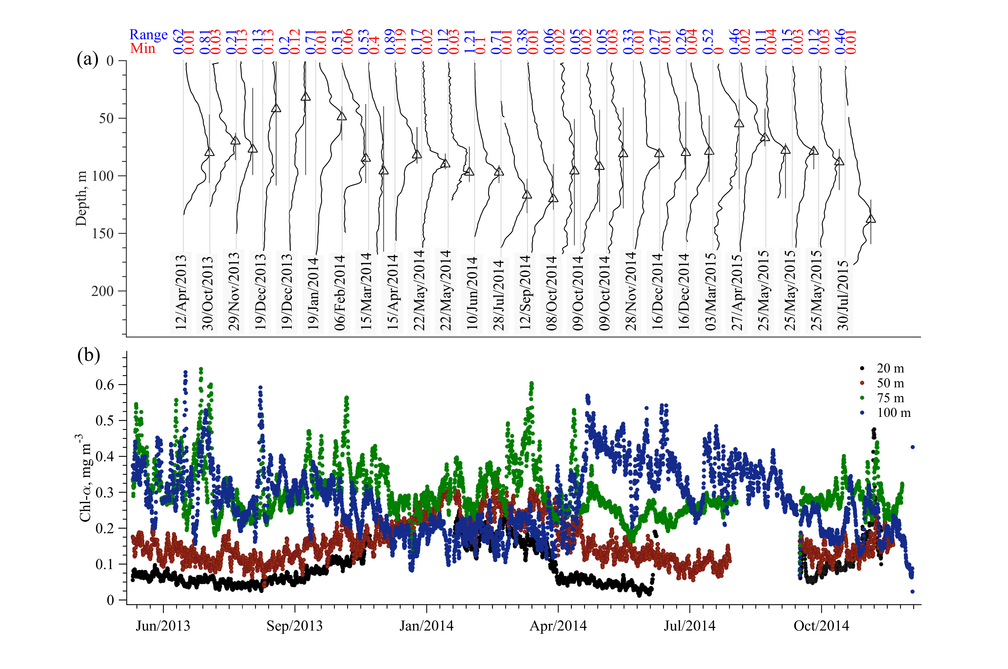
Environmental
conditions
Satellite chlorophyll
In situ chlorophyll
DCM
75 – 100m
April November
100m
75m
20m
50m
Notes:
Oligotrophy → shifted seasonal cycle, deep chlorophyll maximum…
Left
Vertical distribution of chlorophyll → DCM present from April to November, obvious seasonal variability of its depth (triangles), DCM thickness (few tenths of meters in July-August), its core observed between 70 and 150m
DCM thickness ~ 70% of the max value
Right
Phyto horizontal distribution affected by general circulation patterns → chlorophyll patch trapped in anticyclonic ring

Slide 8
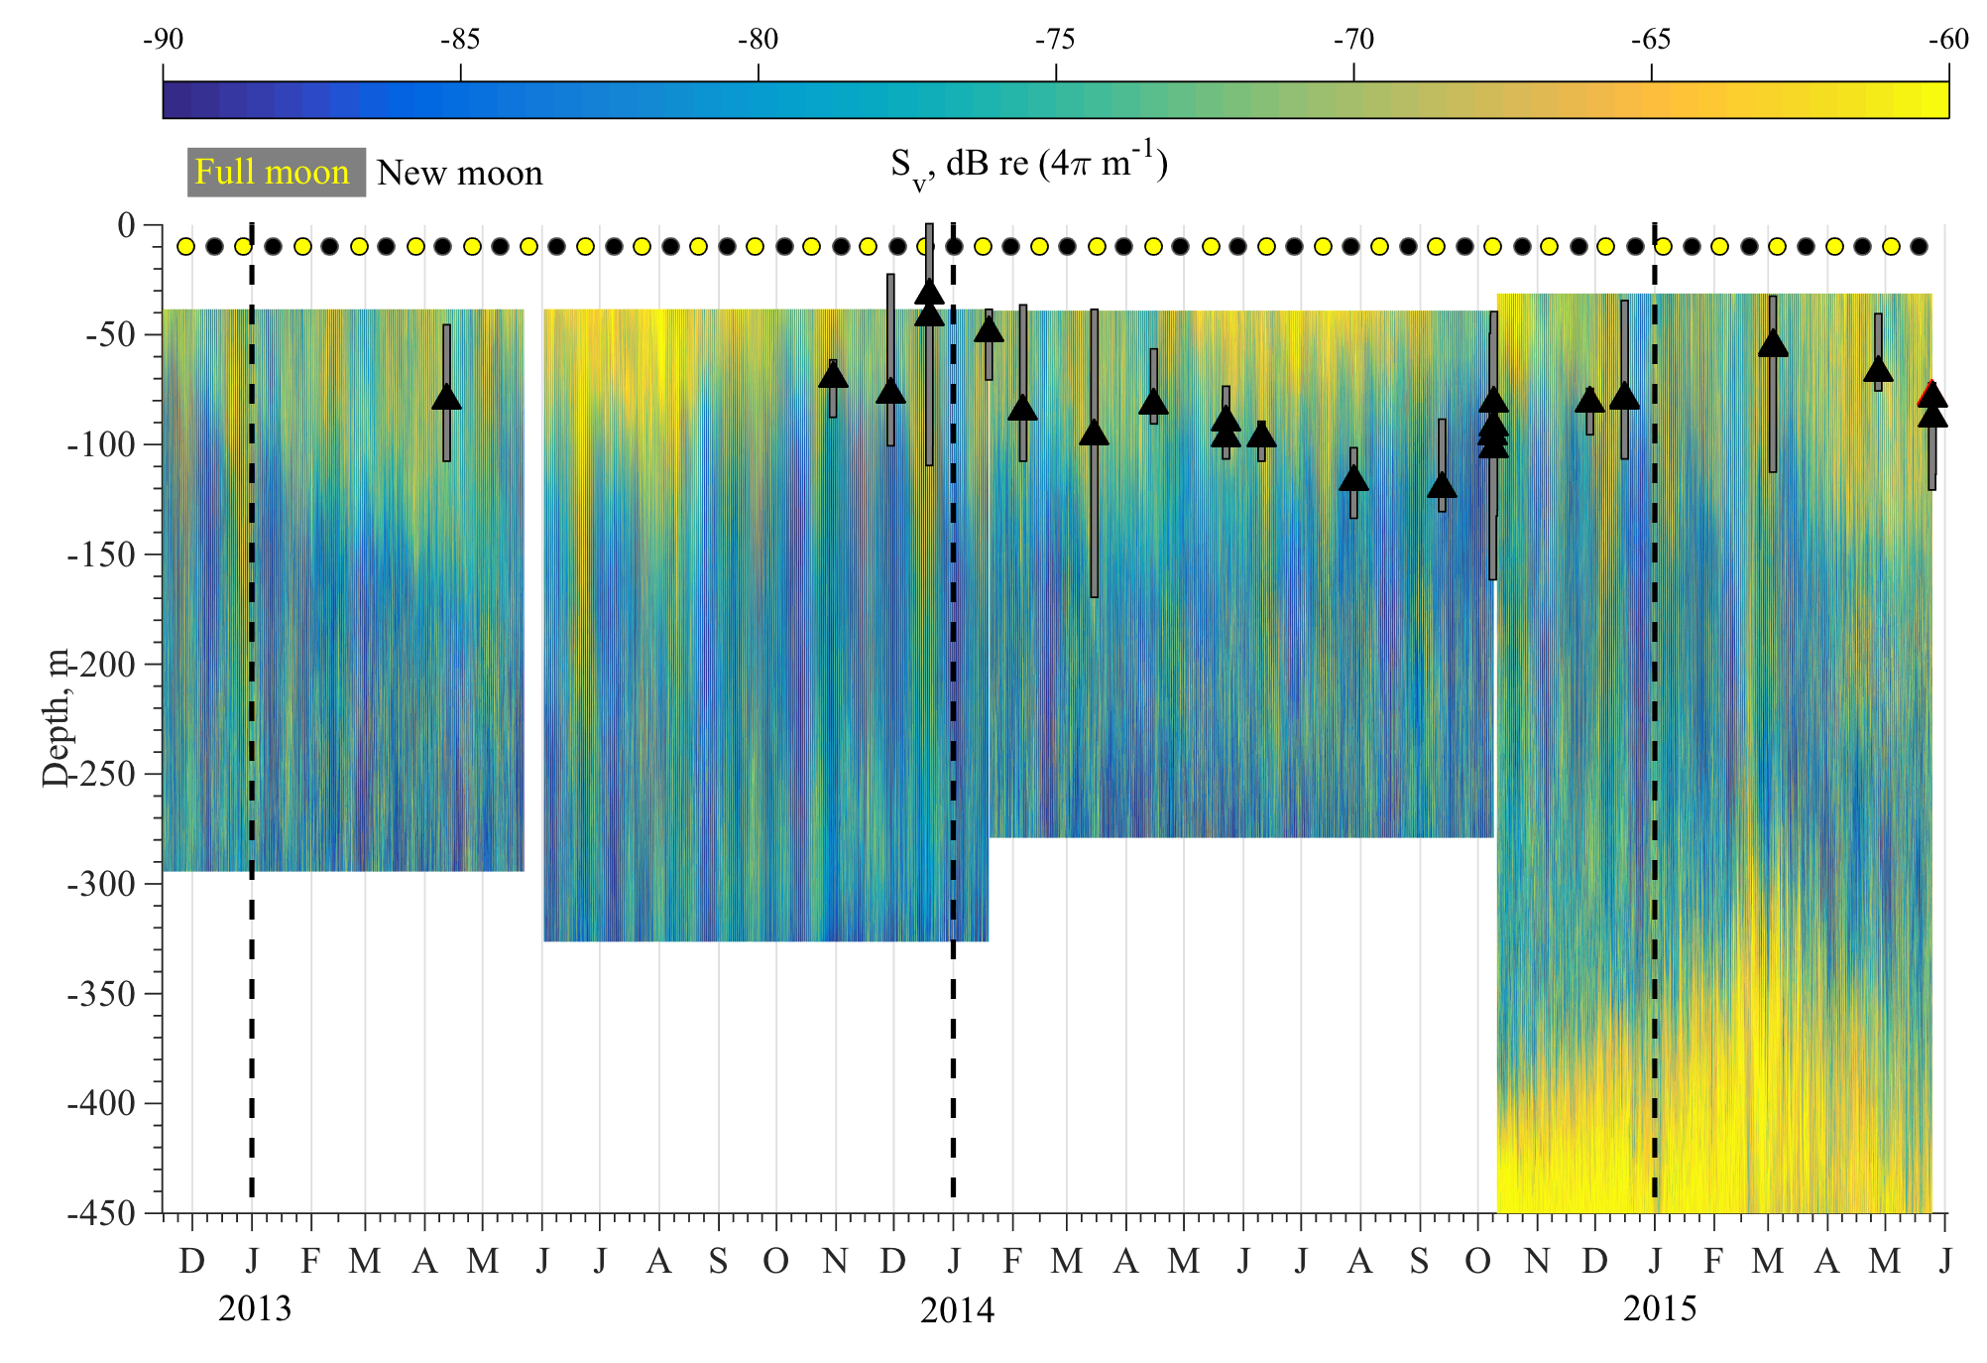
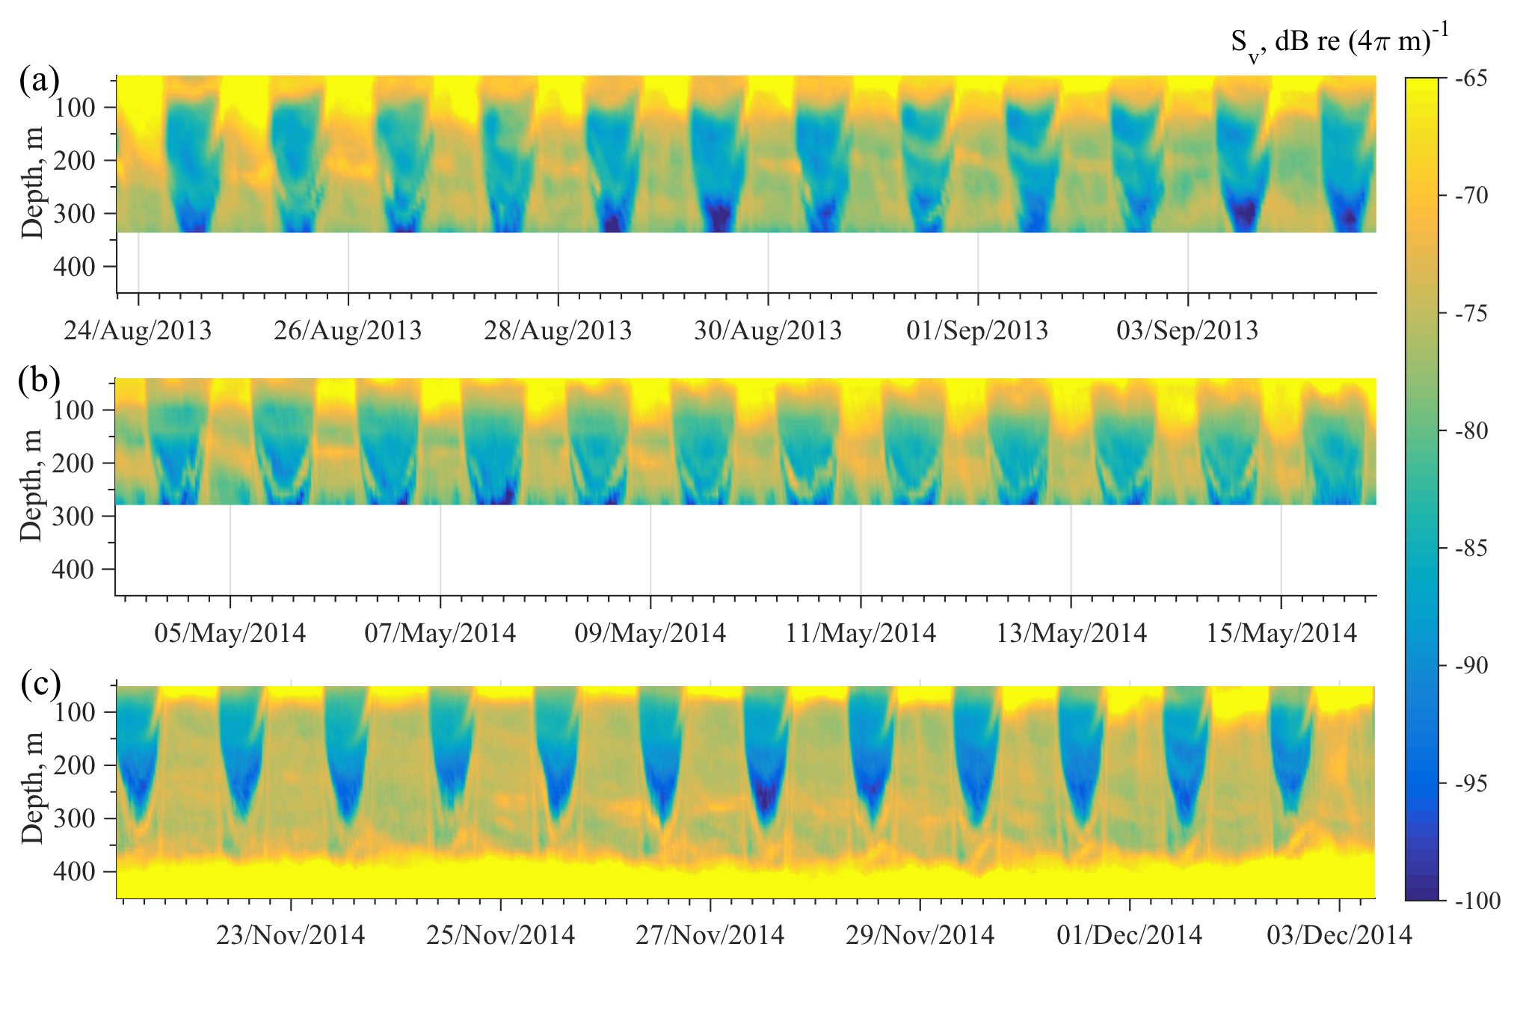
Migration patterns
Volume backscatter
Moon phase
Vertical chlorophyll distribution
Various migrating and non-migrating scatterers
Group C
200 – 100m
dt=1h Bin Size = 16m
Group B
300 – 200m
Migration
Dt=0.5h Bin Size = 20m
Full moon
~50 deeper
Group A
450 -100m
Deeper in summer
Follow Chl ?
No migration
Deep residents
Dt=0.5h Bin Size = 10m
Notes:
Left
throughout the study period there was Migration activity between 50-350m
Non migrating organisms observed at 450m form a deep scattering layer
Migration depth changes seasonally → deeper in summer, shallower in winter and seem to follow Chl
Migration depth changes monthly → effect of moonlight → During full moon they stay deeper ~50m than usual
Right
Three migrating groups distinguished
1st → from deep scattering layer (450m) to the depth of DCM core (~100m)
2nd → from deep scattering layer (450m) to the base of the photic zone (200m)
3rd → from the base of the photic zone (200m) to the depth of DCM core (~100m)
1 group of deep residents which don’t seem to migrate.

Slide 9
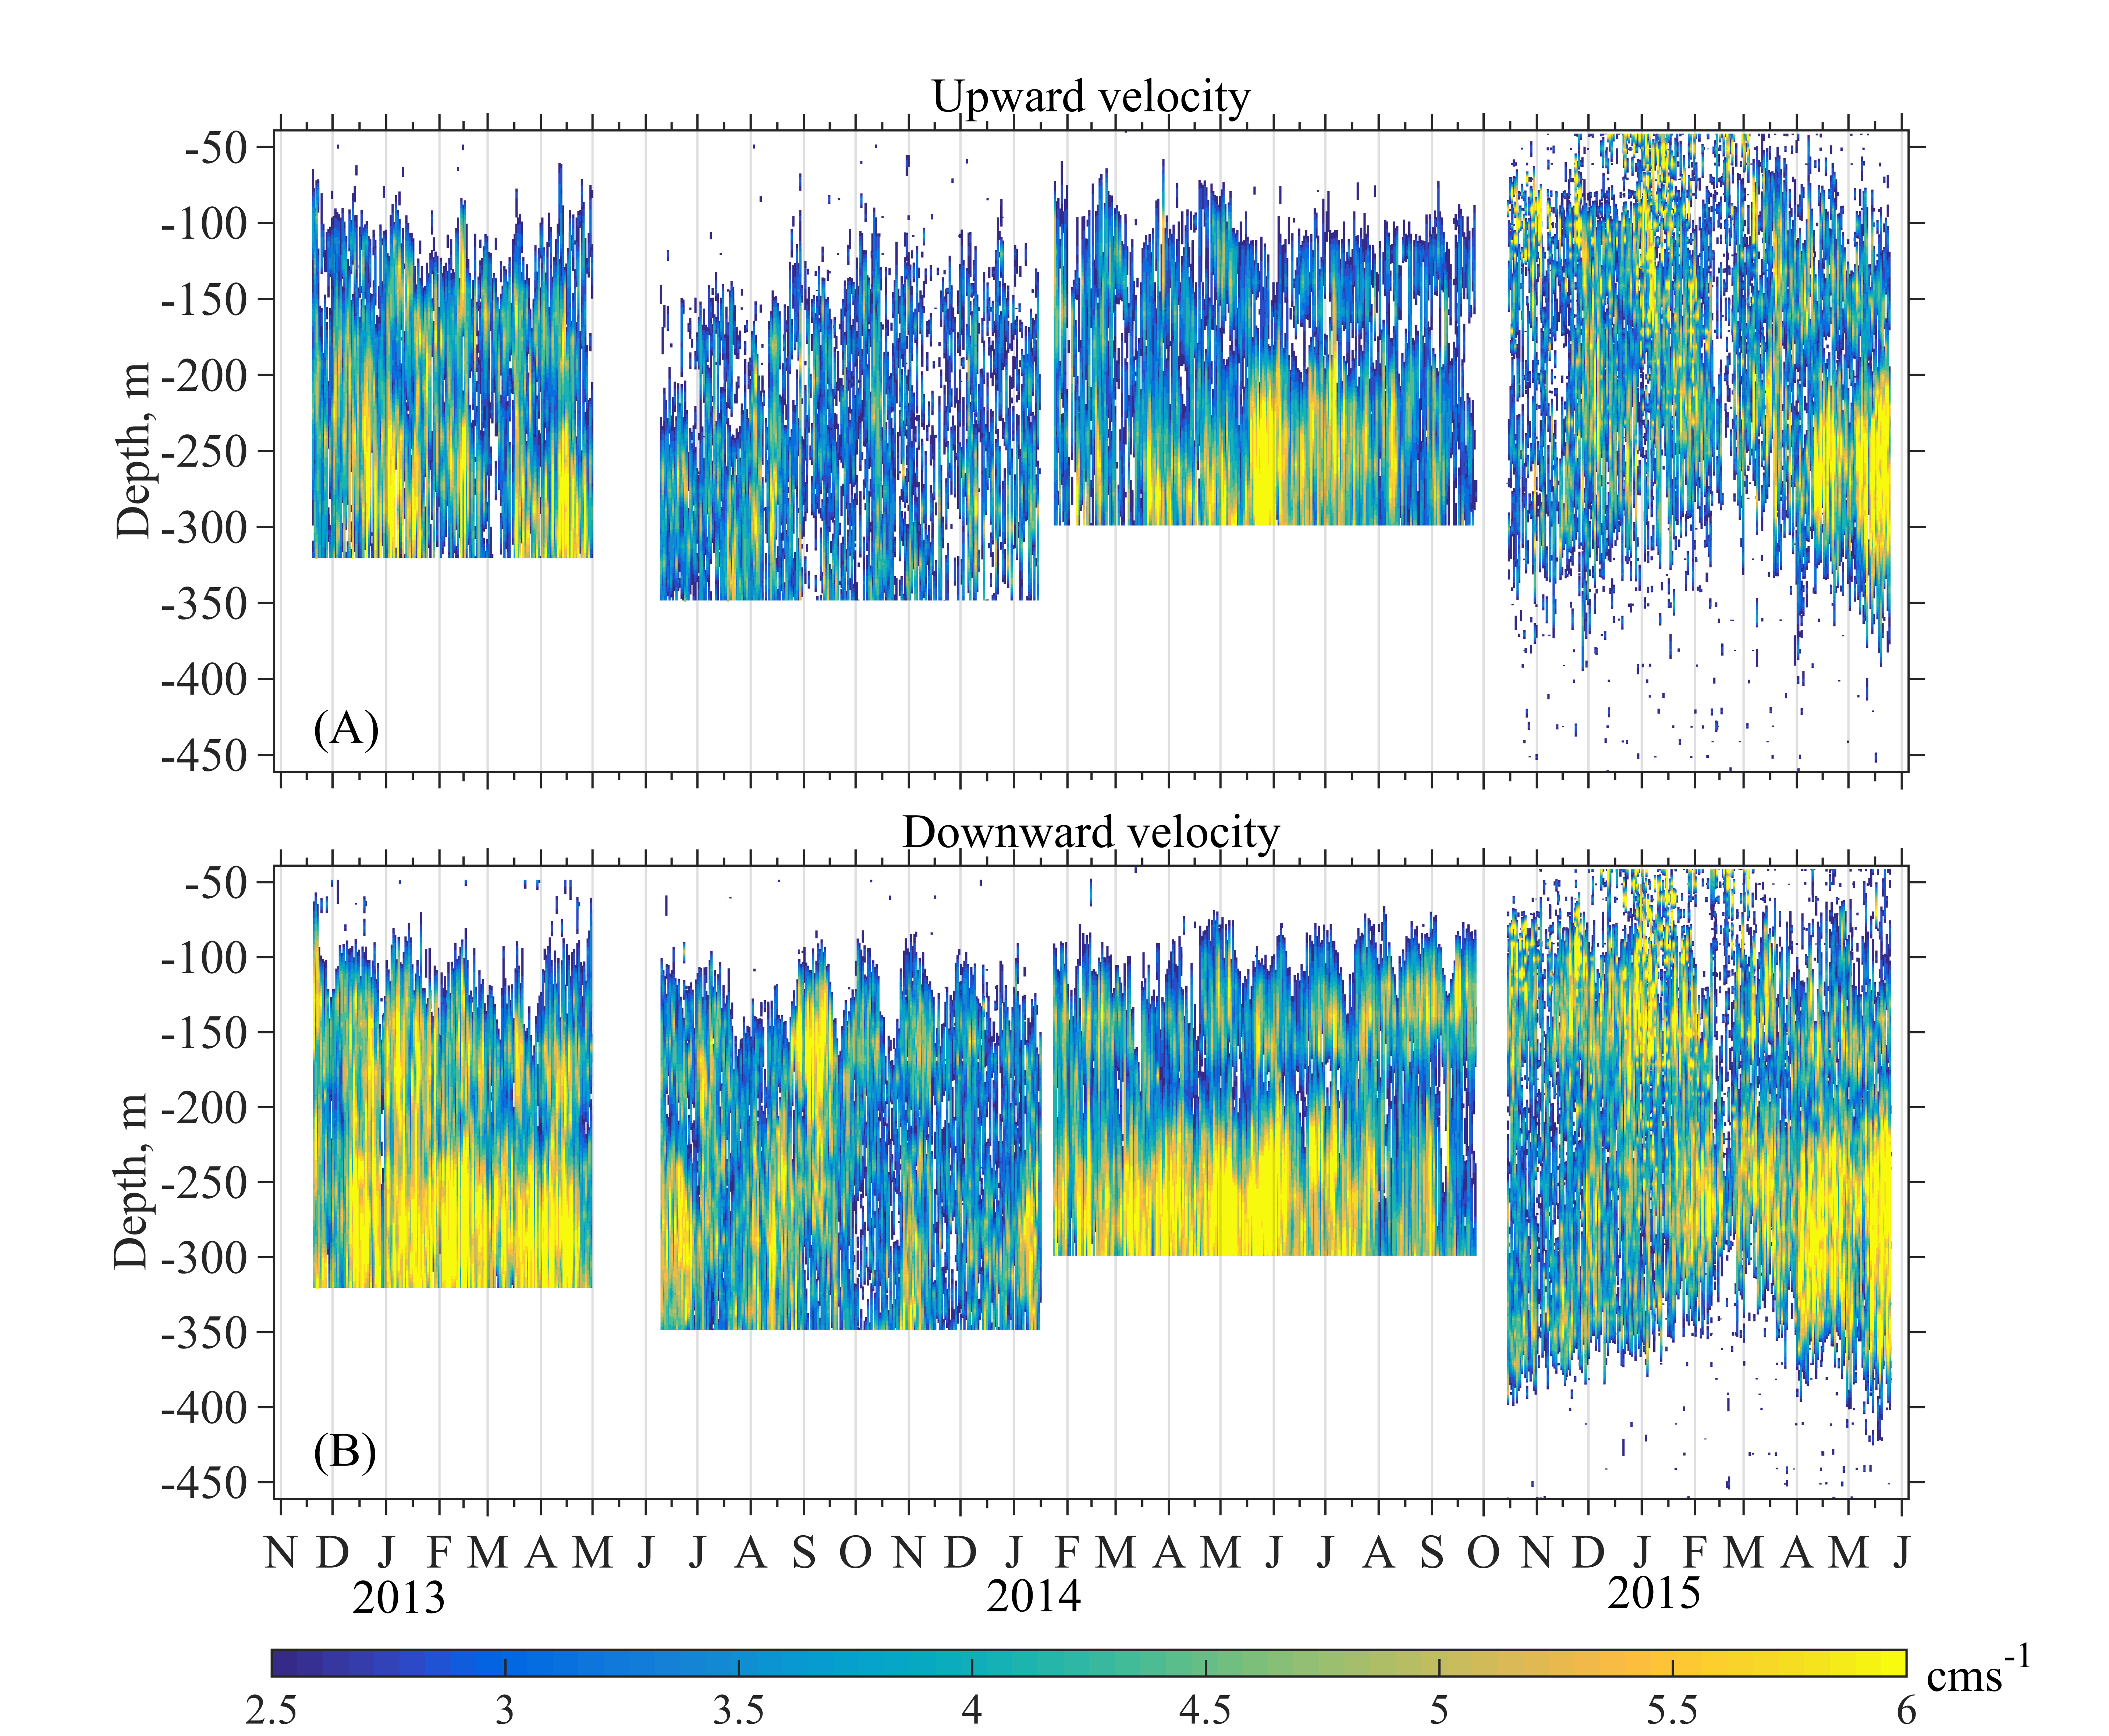
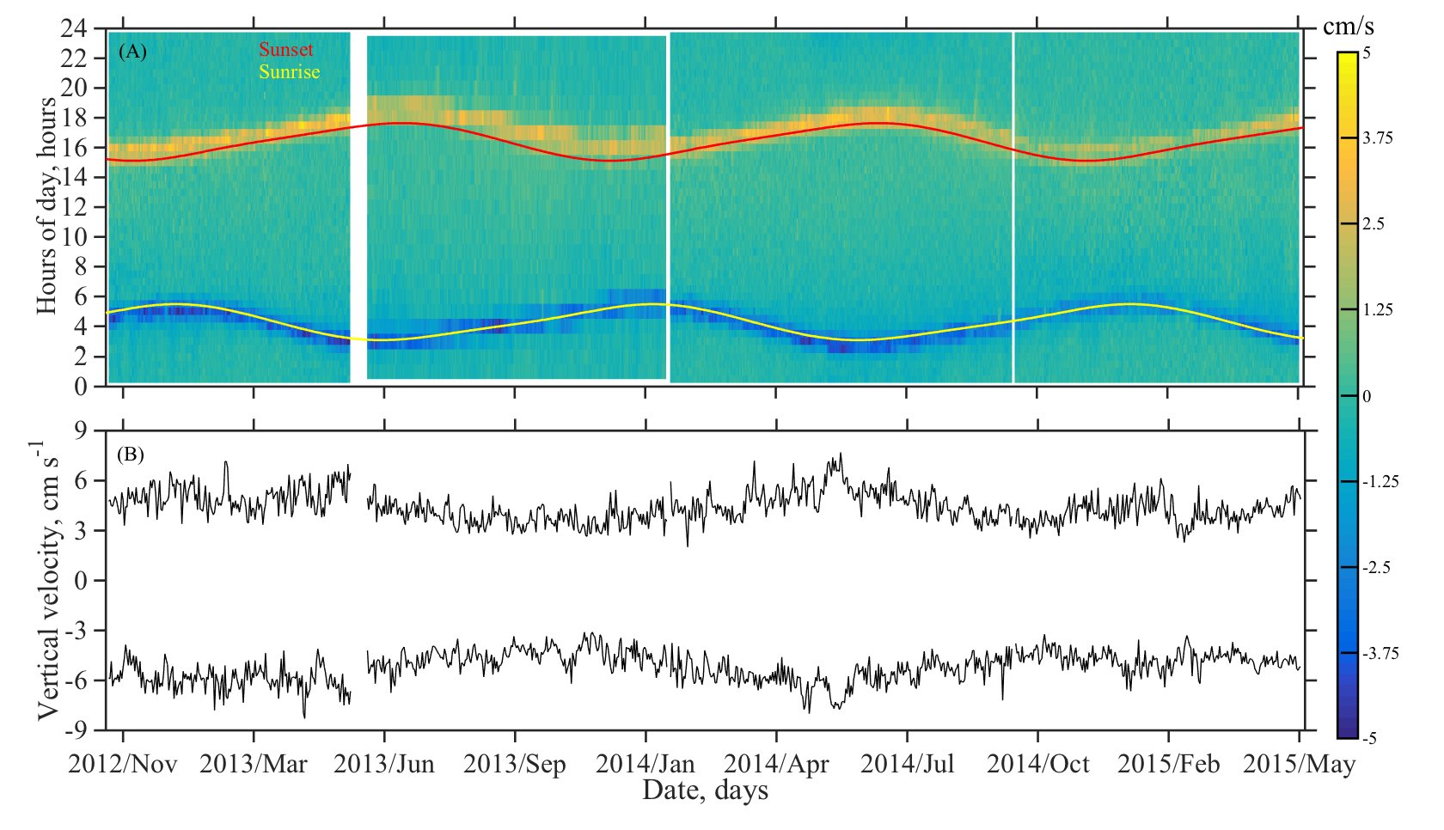
Migration patterns cont..
Upward and downward velocity
Local sunrise-sunset time
Depth averaged vertical velocity
Maximum daily vertical velocity
Upwards
Migration follows seasonal cycle
Daytime
Symmetrical/non
2 hrs
More diffusive upwards movement
Downwards
Velocity changes seasonally & monthly
Notes:
Left
Migration velocity changes seasonally and monthly
Zooplankton does not migrate at constant speed
Motion upwards is more diffusive at the feeding layer compared to motion downwards → feeding activity
Last deployment very small bin size → (+) better resolution of groups (-) noisy velocities
Right
Hour of migration follows sunrise-sunset time → seasonal change of feeding period
2 hours is the activity either going up or down
Down movement is symmetrical around the sunrise ie it starts 1 hour before and finishes one hour after sunrise.
Upwards movement starts after the sun has set
When feeding time is limited speed increases – when feeding time is more speed drops – although the amount of food available seems also to play a role
Motion downwards is faster by ~1cm/s compared to motion upwards → gravity effect

Slide 10
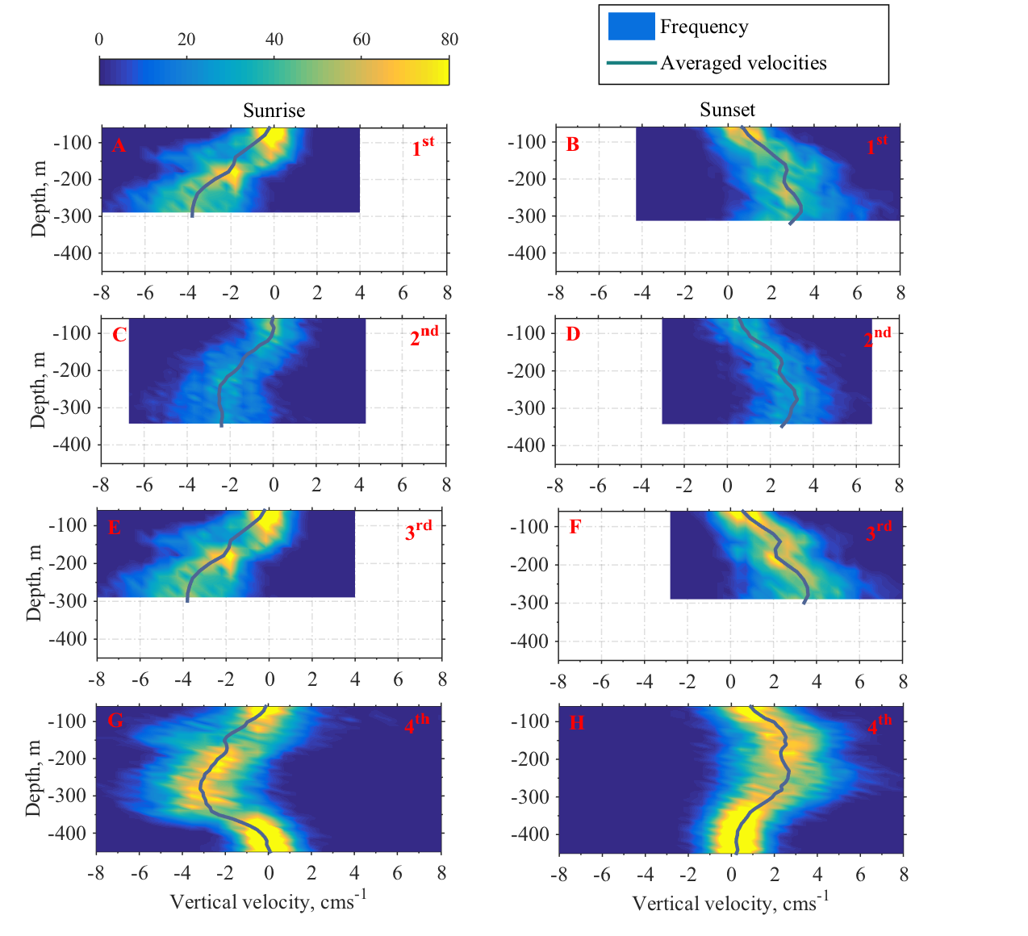
Migration patterns cont..
Seasonal vertical velocity distribution
Vertical velocity distribution at:
sunrise & sunset
Short night
Long night
Food at deep
Food at shallow
Notes:
Left
Largest migration velocity at between 250 and 300m
Largest burst speeds 8cm/s
Low velocity at the base of the photic zone (200m) → the 2nd migrating group
Underestimation of migration velocity during the 2nd deployment → low sampling rate (1h)
The bin size does not seem to affect 12, 16, 20, 10m in contrast with the frequency all are ½ hr except the second which is 1h
Right
Seasonal variation of motion downwards between 250 and 350m → ?
Seasonal variation of motion upwards between 150 and 200m → ?
In summer when the night is shorter downwards velocity increases below 200-250 where in winter when it has more time it slows down – ERNERGETICS
In summer the upward velocity drops above 200m due to exploitation of food (DCM) while in Spring when food is at the surface layer it maintains relatively higher speeds
The apparent slow down at 200m in the upward movement is due to the group B residing at that depth

Slide 11
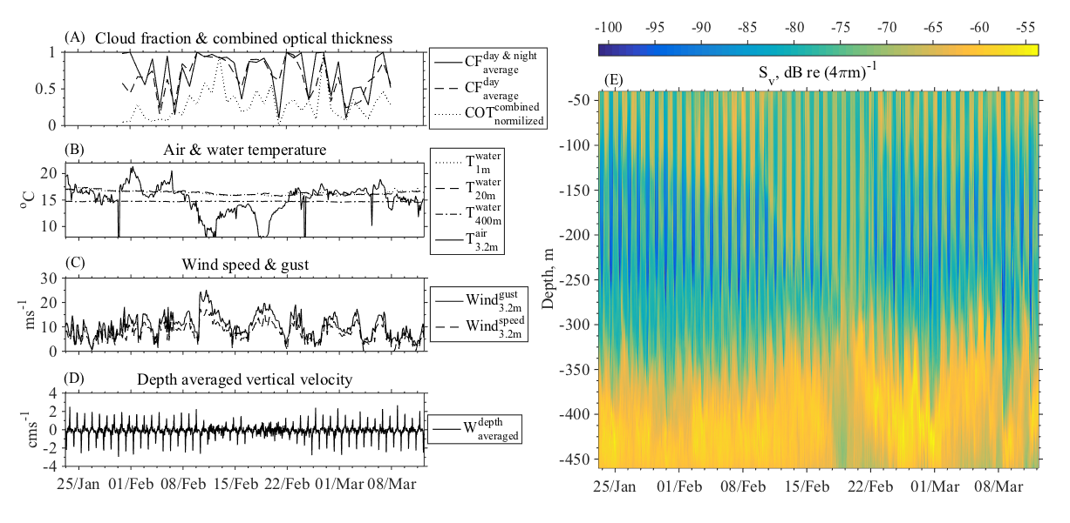
Migration patterns cont..
Effect of an extreme meteorological event
Weak daily
migration
Uplift
2 months
Notes:
Sky overcast, strong wind, low temperature
Zooplankton still migrated
at lower speed
weak daily migration diffuse colour (yellow)
deep scattering uplifted – a biological surface signal that has propagated to 400m
deep scattering layer large daily vertical displacement lasted for one month (a long period after the events)
There seems to be a memory in the system in the case of the deep residents ie. When the extreme event hits the deep, zooplankton adopts quickly ~5d. Then a second event hits so the zoo is likely to expect a third one and keeps the “bad weather” behavior.
In contrast the migrating ones as soon as the event passes they continue the “buisness as usual” behavior.

Slide 12


